Slide 1
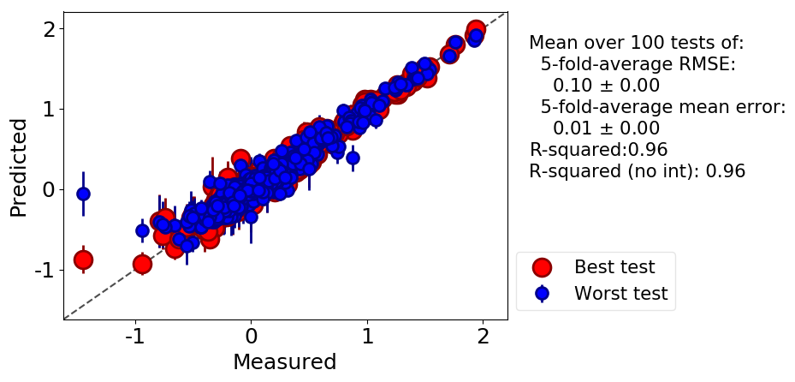


Density Functional Theory (DFT) and Machine Learning
Dane Morgan, Benjamin Afflerbach, Ryan Jacobs
(University of Wisconsin – Madison, WI USA)
Machine Learning for Materials Research (MLMR) &
Workshop on Machine Learning Quantum Materials
https://www.nanocenter.umd.edu/events/mlmr/program/
August 2, 2018
Notes:
Add CMG logo????

Slide 2
Outline
Introduction to DFT
Machine Learning of DFT Based Data

Slide 3
Atomistic Modeling Framework
Hamiltonian H
(Basic physics of system)
Solve + Simulate
(Derive static, dynamic, thermodynamic properties from H)
Analyze
(Derive macro properties from calculations)

Slide 4
Hamiltonians
Atomistic modeling efforts generally start with a Hamiltonian (H) that is a function of the relevant degrees of freedom, usually atom positions/momenta ({r},{p}) and sometimes electron positions/momenta ({R} ,{P}).
H determines the basic physics of the system (static equilibrium, time dynamics, thermodynamics), and essentially all phenomena of interest can be derived from H.
The challenge of atomistic modeling is to make H accurate and fast.

Slide 5
Two Classes of Atomic Scale Hamiltonians
Quantum mechanical modeling
Solves the Schrodinger equation for the electrons to get electronic structure
Also gives total energies
Slow because solving quantum equations for all the electrons is hard (typically 10² atoms, time~10ps)
Density functional theory is a quantum mechanical method
Potential modeling (“Classical”, “Molecular Modeling”, “Semi-empirical potentials”)
No electrons so no electronic structure
Gives energies
Faster because electrons are not treated explicitly (typically 10⁸ atoms, time~10ns)

Slide 6
The Total QM Hamiltonian
KE_{Ions}
Ion-Ion
Ion-Elec
KE_{Elec}
Elec-Elec
Treat Classically
Treat classically Ewald sum
Treat quantum
assuming fixed ion positions (Born-Oppenheimer approximation)
This becomes the Quantum H

Slide 7
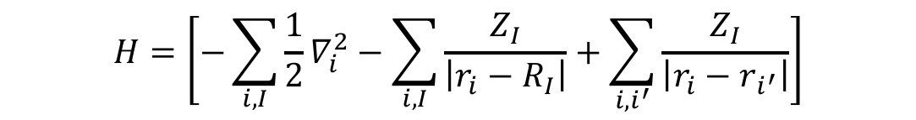
The Problem
Solving the Schrodinger equation exactly for interacting electrons is impractical (at present) due to the electron-electron interaction
This has as a solution a wavefunction that depends on all electrons (3N_{e} dimensional function) and is intractably complex for any realistic system.
$$H=\left[−\sum_{i,I}{\frac{1}{2}∇_{i}^{2}}−\sum_{i,I}{\frac{Z_{I}}{\left|r_{i}−R_{I}\right|}}+\sum_{i,i^{′}}{\frac{Z_{I}}{\left|r_{i}−r_{i^{′}}\right|}}\right]$$
KE_{Elec} Ion-Elec Elec-Elec

Slide 8
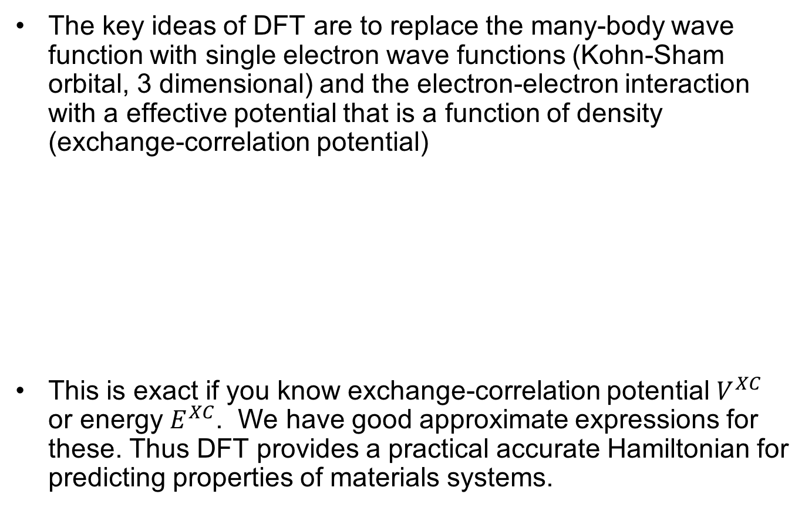
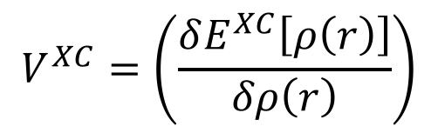
Density Functional Theory (DFT)
Walter Kohn, early 1960’s (Nobel prize in Chemistry 1998)
The key ideas of DFT are to replace the many-body wave function with single electron wave functions (Kohn-Sham orbital, 3 dimensional) and the electron-electron interaction with a effective potential that is a function of density (exchange-correlation potential)
This is exact if you know exchange-correlation potential $V^{XC}$ or energy $E^{XC}$. We have good approximate expressions for these. Thus DFT provides a practical accurate Hamiltonian for predicting properties of materials systems.
$Hφ_{i}\left(r\right)=\left[−\frac{1}{2}∇_{}^{2}−\sum_{I}{\frac{Z_{I}}{\left|r−R_{I}\right|}+\int{dr^{′}\frac{ρ\left(r^{′}\right)}{\left|r−r^{′}\right|}}}+V^{XC}\left(r\right)\right]$ $φ_{i}\left(r\right)$= $ε_{i}φ_{i}\left(r\right)$
$$V^{XC}=\left(\frac{δE^{XC}\left[ρ\left(r\right)\right]}{δρ\left(r\right)}\right)$$

Slide 9
Basic Output
QM codes solve the Schrodinger equation to get electron
Wavefunctions=eigenfunctions=eigenstates
Energies=eigenvalues
These can be used directly to get electronic structure
These can be used to get energies and forces

Slide 10
Energies/Forces
Can be used for
Static relaxation for atomic coordinates (F=0).
Basic phase stability determination.
Molecular Dynamics (need a=F/m to update x,v each timestep).
Monte Carlo (need E to decide next step in Metropolis algorithm).
Limitations: 10²-10³ atoms, 10⁻¹¹-10⁻⁹ s
Explore molecular dynamics with online/mobile app AtomTouch
https://www.brainpop.com/games/atomtouch/

Slide 11
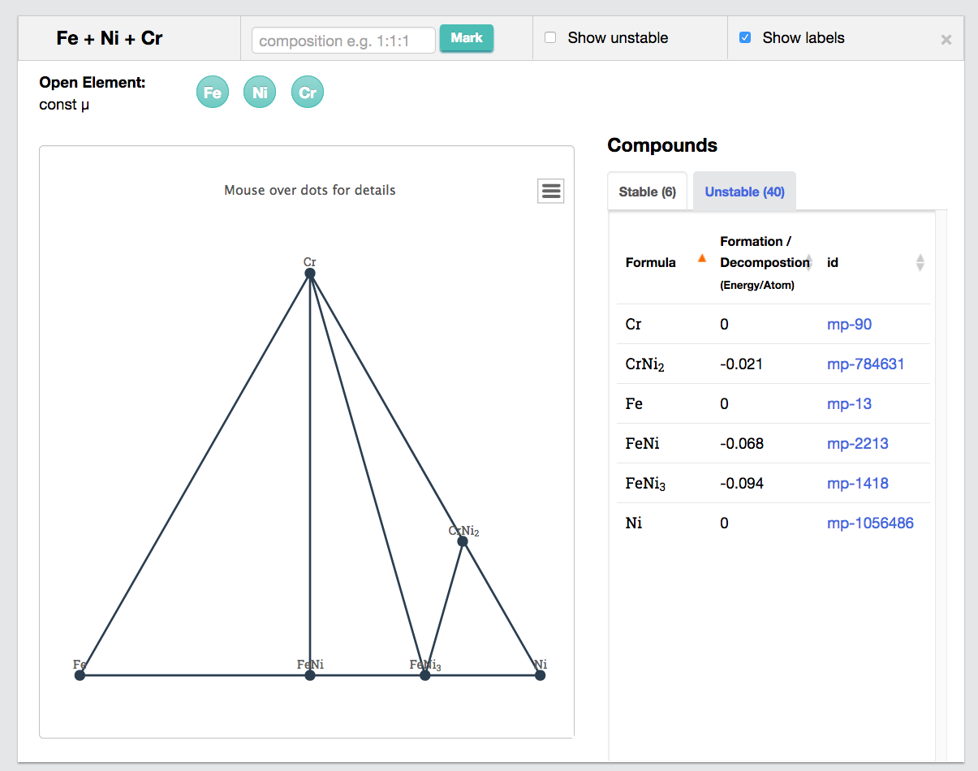
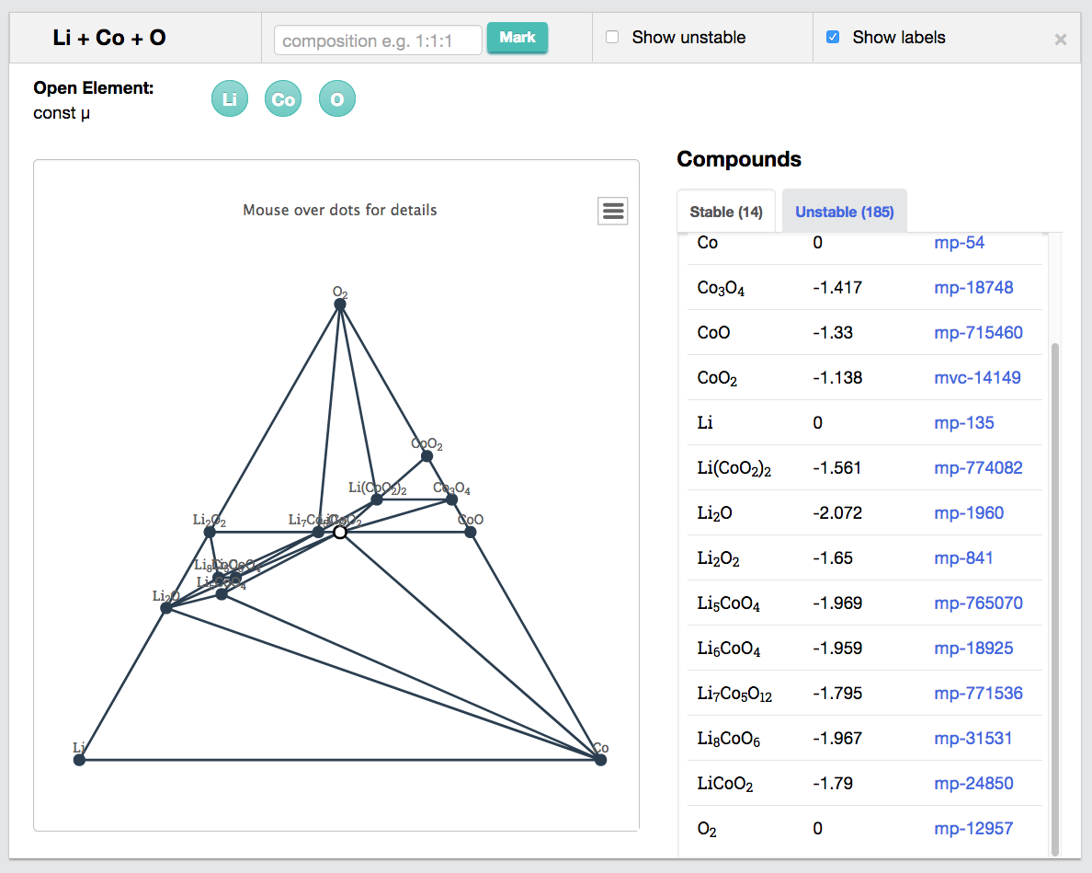
DFT Phase Diagrams
https://materialsproject.org
Useful, but missing Fe-Cr Laves phase
Shows stable LiCoO2 but many competing phases - can guide synthesis efforts

Slide 12
Electronic Structure
The electronic structure = the wavefunctions and energy levels of the electrons
Relevant for calculating (among other things)
Optical properties (transitions between electronic states)
Electrical conductivity (mobility of electrons, scattering of electrons between states)
Excited electron states due to thermal (or optical) excitations
Type of bonding (ionic, covalent, metallic, sigma vs. pi binding, etc.)
Tunneling rates (e.g., for Magnetic Tunnel Junctions)
Ways we represent the electronic structure conveniently
Wavefunctions
Usually too complex to simply plot usefully
Usually represent with charge density
Electron energies are generally represented with
Density of states
Band structure

Slide 13
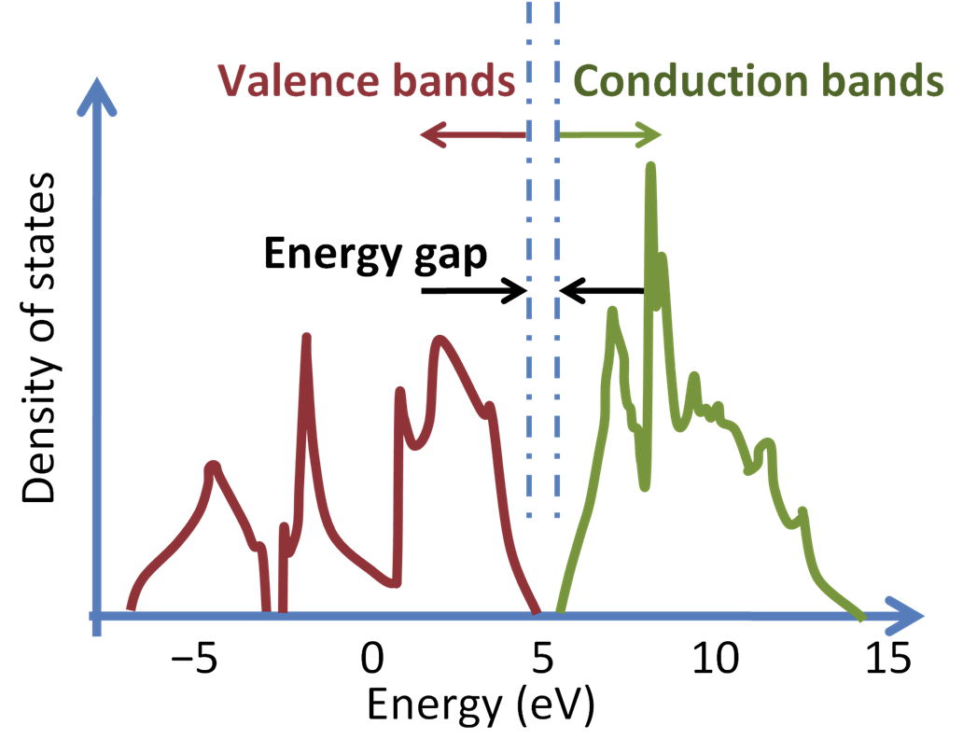
Band Gap for Solar Materials Design
Silicon
http://en.citizendium.org/images/3/38/Silicon_density_of_states.PNG

Slide 14
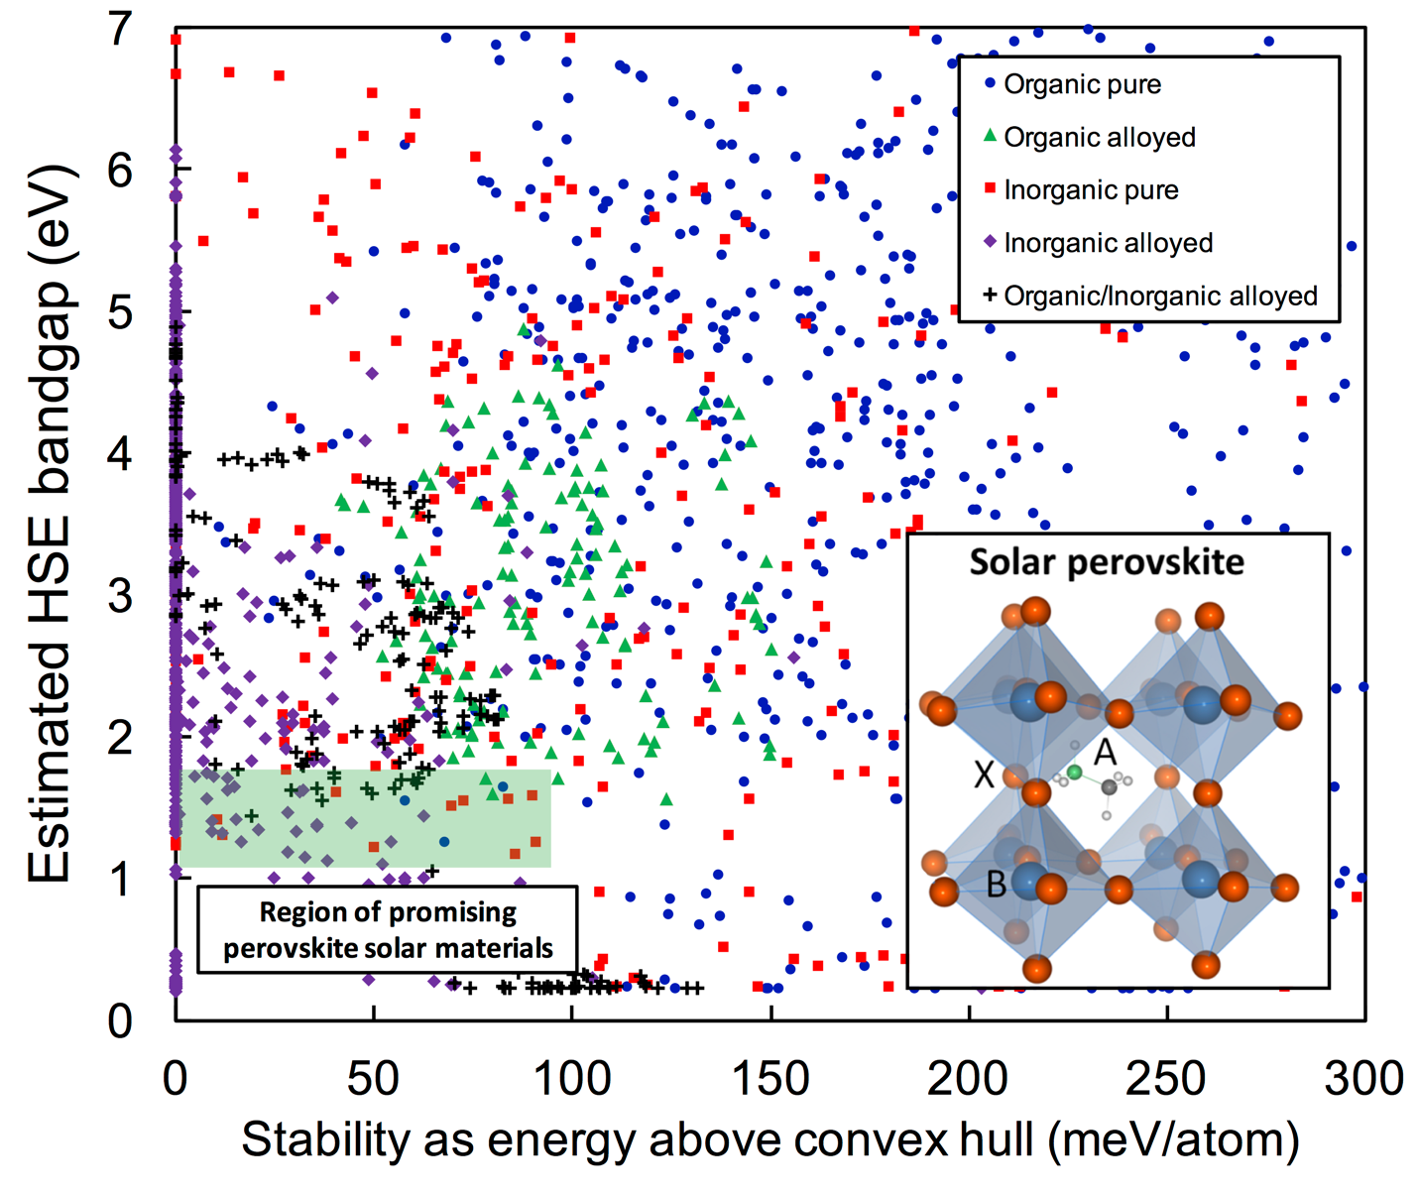
Band gap screening of new halide perovskites for solar cells
Jacobs, et al. submitted (2018)
UNPUBLISHED WORK – PLEASE DO NOT DISSEMINATE

Slide 15
DFT and Machine Learning
There are some natural connections between DFT (typical for any expensive simulation) and machine learning.
Use more accurate method to improve DFT: Machine learning exchange-correlation functions.
Use DFT to improve less accurate methods: Machine learning potentials.
Accelerate property prediction with DFT trained models: Predicting DFT data with regression.
Accelerate property optimization with DFT trained models: Active learning for DFT-based optimization.

Slide 16
DFT and Machine Learning
There are some natural connections between DFT (typical for any expensive simulation) and machine learning.
Use more accurate method to improve DFT: Machine learning exchange-correlation functions.
Use DFT to improve less accurate methods: Machine learning potentials.
Accelerate property prediction with DFT trained models: Predicting DFT data with regression.
Accelerate property optimization with DFT trained models: Active learning for DFT-based optimization.

Slide 17
What is Solute Diffusion and Why Does it Matter?
The way an element X (solute) moves in a host M is governed by its diffusion coefficient.
Diffusion controls many processes, from semiconductor performance to battery charging rates to nuclear steel degradation.
Diffusion of X in M is often unknown or poorly (10% of values for basic metals).
D=D₀exp(-E_{A}/k_{B}T), key property is E_{A}.
Can be calculated by ab initio methods (~10k CPU hours/M-X system). We will use computed database.
Cu in Fe
⨉ 10⁶
range
Mamivand, et al. Submitted ‘18

Slide 18
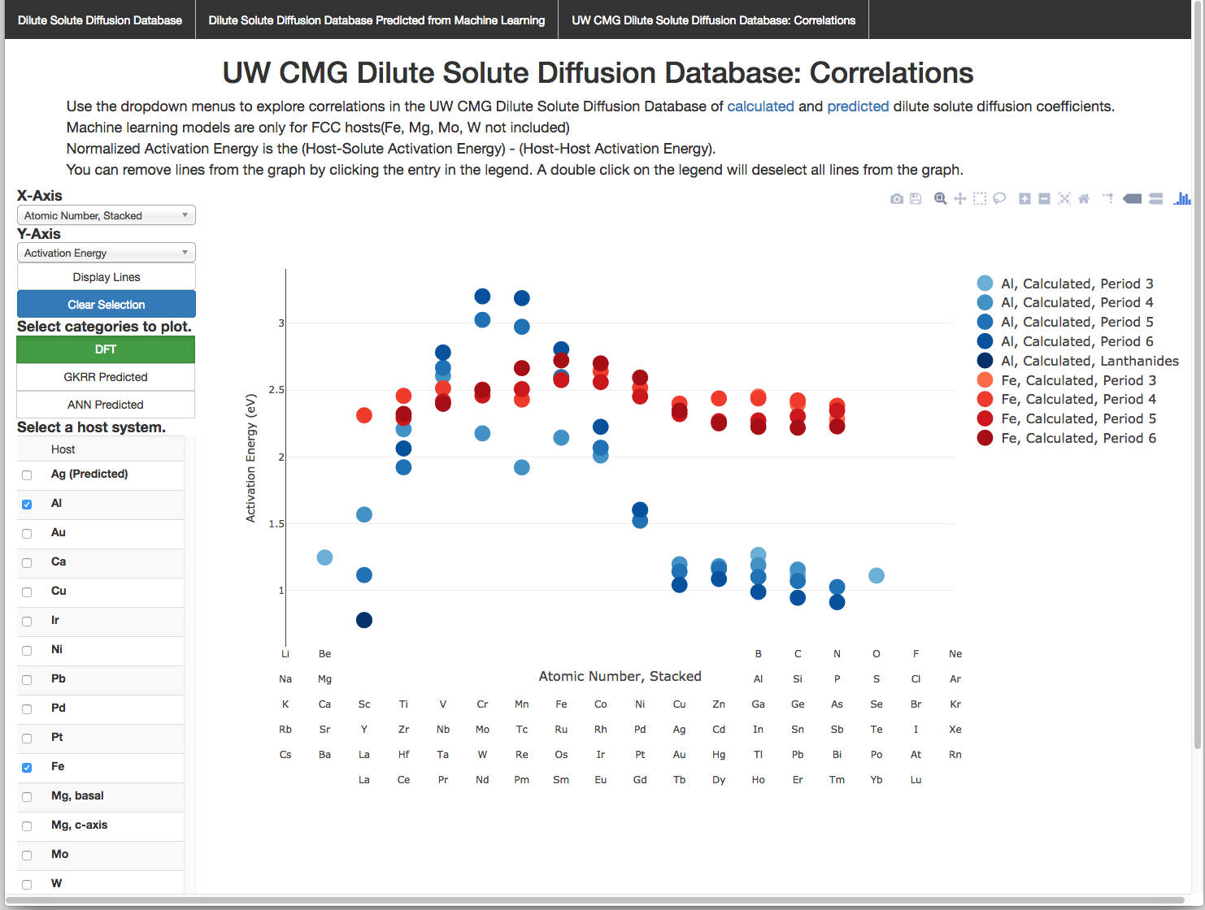

Diffusion Database http://diffusiondata.materialshub.org/
Impurity diffusion of X in host M for over 400 systems.
New kinetic data for science and materials design.
Web application for plotting and exploring data.

Slide 19
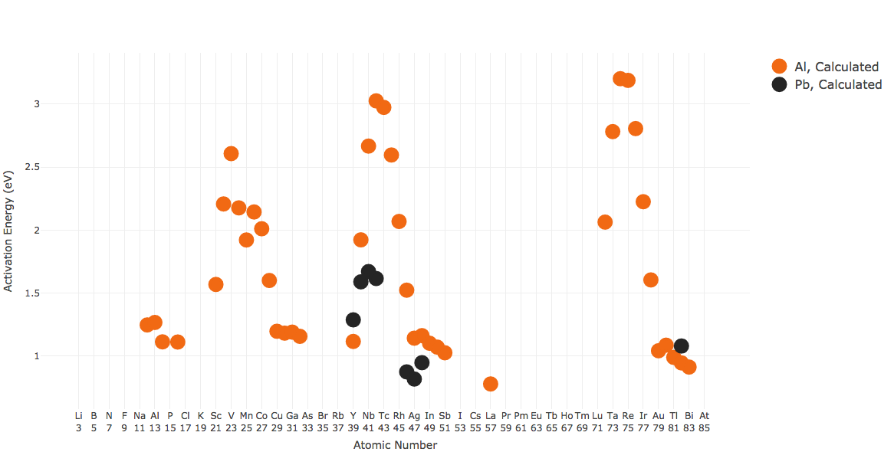
Completing the Database
A lot of missing data!
Considering just FCC, HCP, BCC hosts and metallic elements: ≈40 hosts, ≈50 impurities => ≈6000 systems, ≈60m core-hours.
Present coverage is ≈ 7%.
How can we quickly (and cheaply ☺) get to 100% coverage? Try Machine Learning!
Notes:
Mining estimate:
---------------------------
10 impurities in each host = 10*60 = 600, x 3 structures = 1800
Full database estimate:
---------------------------------
60 feasible elements as hosts * 60 feasible elements as solutes in each = 3600 systems (also self-diffusion)
3600 systems x 3 host structures = 10,800 total alloys
10,800 – 1800 = 9,000 missing alloys
Diffusion database size:
---------------------------------
Smithells Metal Reference Book
Table 13.2 for experimental tracer impurity diffusion in metals has ~ 900 alloys
Table 13.4 for experimental chemical diffusion coefficients has ~700 alloys, although some alloys have different concentrations (not dilute alloys)
Gale, W. F, and T. C. Totemeier (eds). Smithells Metals Reference Book, Eighth Edition. Butterworth-Heinemann. © 2004. Books24x7. <http://common.books24x7.com.ezproxy.library.wisc.edu/toc.aspx?bookid=25368> (accessed August 13, 2015)
CPU hours
---------------------
Average CPU hours NOT counting any OUTCAR restarts was 6000 per system (Fe host)
Adding all restarts and checkpoints as well as host variation easily puts estimated CPUs at 10000 per system.

Slide 20
Machine Learning Approach
Assume Activation energy (measured relative to host) = F(Host descriptors, Impurity descriptors). [1]
Descriptors = elemental properties like melting temperature, bulk modulus, electronegativity, … and their ratios, differences, etc. [2]
F is determined using Gaussian Process Regression (Gaussian Kernel) (GPR) (similar results from other methods but GPR provides uncertainty estimates).
Fit F with calculated data (15 hosts, 440 M-X pairs), test with cross-validation (k-fold, host-leave-out), then predict new M-X pairs. [3]
[1] Y. Zeng and K. Bai, Journal of Alloys and Compounds 624, p. 201-209 (2015); [2] L. Ward, et al. Comp. Mat. ‘16; Datasets expanded from L. Ward and C. Wolverton; https://bitbucket.org/wolverton/magpie, http://oqmd.org/static/analytics/magpie/doc/; [3] H. Wu, et al., Comp. Mat. Sci ’17; H. Lu, et al., in prep ‘18
Notes:
Look how RF DTs does regression – DONE.
Use Scikitlearn.
How are descriptors set: - Take arithmetic average of elements in composition - Take composition-weighted average of elements in composition - Take max value of descriptor for elements in composition - Take min value of descriptor for elements in composition - Take difference (max-min) of descriptors for elements in composition - List descriptors for elements decomposed by site. For example, in AA'BX3 perovskite, elemental descriptors will be listed for the element present at A, A', B and X, separately. We also have a feature where the user simply inputs their composition list of elements decomposed by site, and MASTML automatically builds the full material composition and generates all the above descriptors.
What descriptors are most important: At #, size measures, Tmelt, some elect structure (Np valence electrons). Some that make little sense, eg, “Is X Hexagonal structure”

Slide 21
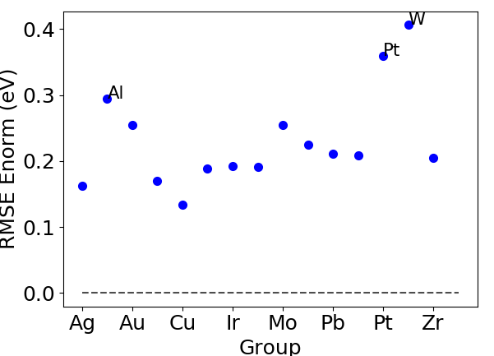
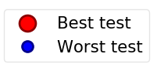
Predicting Activation Energy (GPR)
H. Lu, et al., in preparation
5-fold CV Avg over 100 test
RMSE score: 0.10 eV (~4x error in D at T=1000K)
R² = 0.96
Standard deviation of data: 0.44 eV
Leave out host CV RMSE score: 0.23 eV
Extrapolation much harder than interpolation. Some work well, some not so well.
Model gives good predictions, but still needs work to assess errors
UNPUBLISHED WORK – PLEASE DO NOT DISSEMINATE

Slide 22
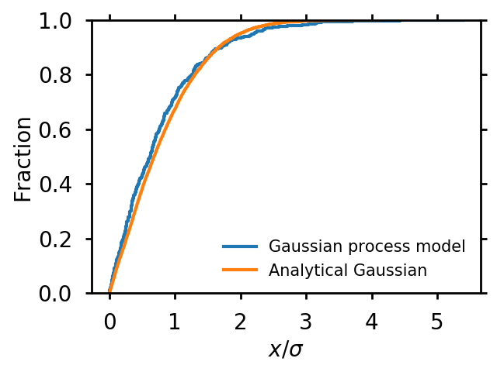
Workflow and Challenges for Predicting DFT Data and the MAST-ML Tool
New tool for this type of work
Develop candidate descriptors and perform descriptor selection – need quick access to databases (e.g., elemental props), selection approaches (e.g., PCA), cost functions (e.g., cluster CV).
Perform fits with different models – need quick exploration of models and hyperparameter optimization.
Assess model accuracy/domain - need multiple CV approaches, error estimate approaches (e.g., GPR, RFDT weak learner averaging, closeness measures).
Want blizzard of statistics and workflow management for all stages.
-ML
https://github.com/uw-cmg/MAST-ML
General error bar assessment
H. Lu, et al., in preparation
UNPUBLISHED WORK – PLEASE DO NOT DISSEMINATE

Slide 23
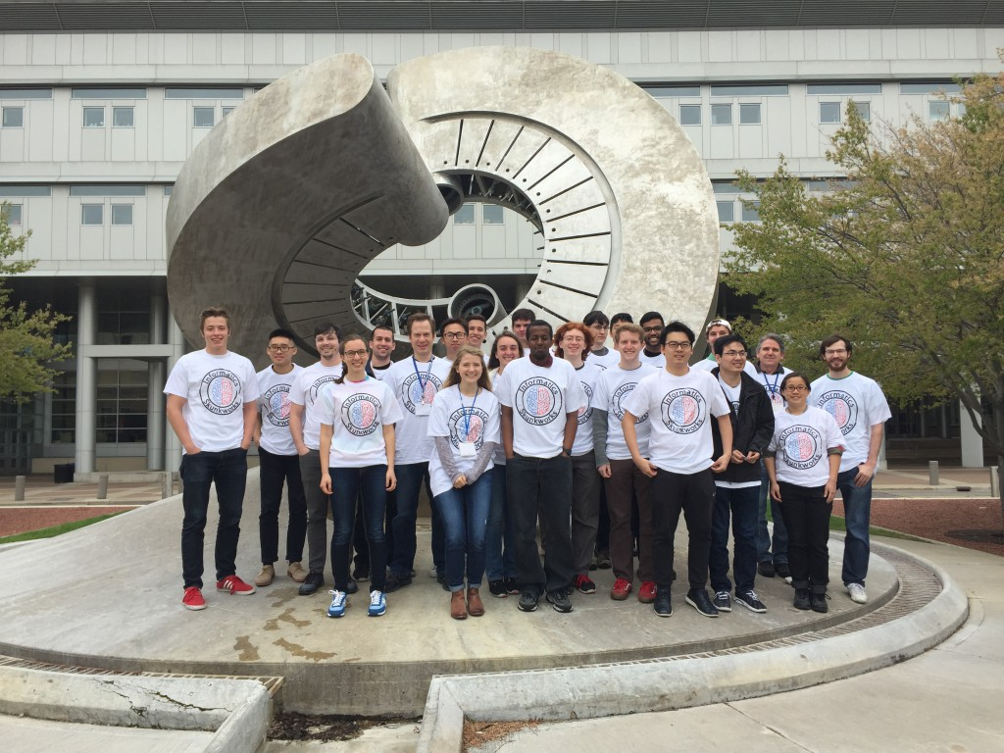
Thank You for Your Attention Any Questions?
Next up: Introduction to the MAST-ML Software Package
Two invitations (Dane Morgan – ddmorgan@wisc.edu)
-ML
2017-04-29
Collaboration on machine learning tools for materials science (MAST-ML)
Collaborate on undergraduate education through Informatics Skunkworks
https://github.com/uw-cmg/MAST-ML
https://skunkworks.engr.wisc.edu/
Notes:
HERE???

Slide 24
Backup

Slide 25
Beyond LDA/GGA
DFT+U: Treats localized electrons better, e.g., in transition metal oxides. ~Same speed as LDA/GGA.
Hybrid Hartree-Fock/DFT (e.g., HSE functional): Treats correlation and many effects better. Good band gaps. ~20x slower that LDA/GGA.
van der Waals interactions, e.g., layer separation in graphite, can be treated with additional terms or functionals (e.g., vdW-DF)
V. L. Chevrier, S. P. Ong, R. Armiento, M. K. Y. Chan, and G. Ceder, Hybrid density functional calculations of redox potentials and formation energies of transition metal compounds, Physical Review B 82, p. 075122 (2010).
 | Mean Error (eV) | Std Dev around mean error (eV)
TM GGA | 1.32 | 0.20
TM HSE | -0.35 | 0.15

Slide 26

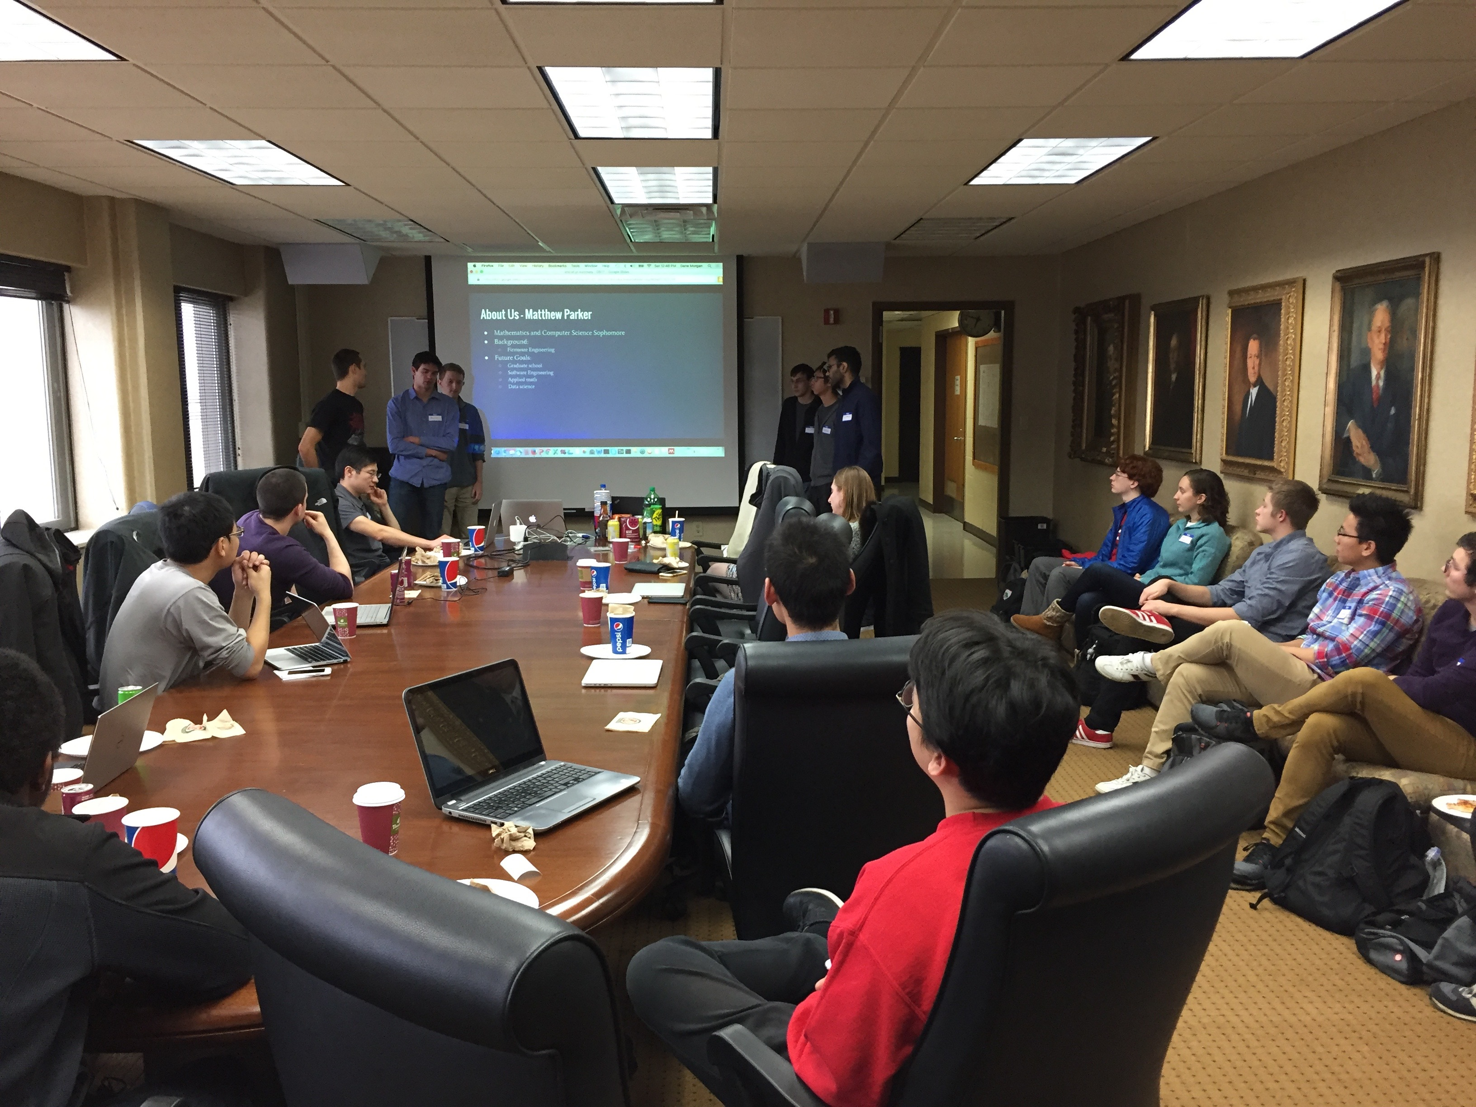
The Informatics Skunkworks https://skunkworks.engr.wisc.edu/
Undergraduate researchers transforming science and engineering with informatics
Building the Future Workforce
Since S15 - Over 70 undergraduates, 7 graduates/postdocs, and 15 faculty/industry from across the country, groups at Hope College (MI), Univ. Puerto Rico (Mayaguez)
Active, project based learning in teamwork, presentation, project management, coding, machine learning, mentoring
Challenging projects in range of science and engineering
Recognition
Highlighted as one of the 32 accomplishments of the first five years of the $500m Materials Genome Initiative
Finalist in the 2017 Wisconsin Innovation Awards
Presentations, student awards, papers published, …
Notes:
Need people to grow parallel efforts at other schools to create a community.

Slide 27
A Brief Introduction to Machine Learning in Materials
Many exciting applications already
Image processing tools for characterization data using both unsupervised and supervised methods methods (including microstructural analysis) (e.g., octahedral tilts and defects in electron microscopy, X-ray structural analysis)
Property database development (e.g., diffusion coefficients, thermoelectrics, battery electrolytes)
Materials design (e.g., phosphors, polymer dielectrics, piezoelectrics, and superconductors)
Text mining of published papers (e.g., for synthesis guidance)
Novel interatomic potentials (e.g., for complex alloy surfaces, acceleration of ab initio molecular dynamics),
Improving ab initio functionals (e.g., corrections for highly correlated systems)
Autonomous experiments (e.g., carbon nanotube synthesis)
Many specific features vs. general problems
Can have ”Big Data” (synchrotron light source) and more often ”small data” (hundreds of diffusion coefficients) challenges
Enormous amount of physics/chemistry/mse in data (composition, microstructure, physical laws)
Notes:
Figure 2: Publications per year in materials informatics (Web of Science search of ("Machine Learning" or "artificial intelligence" or “Informatics”) and ("materials science" or "materials engineering"), with some errors corrected.

Slide 28
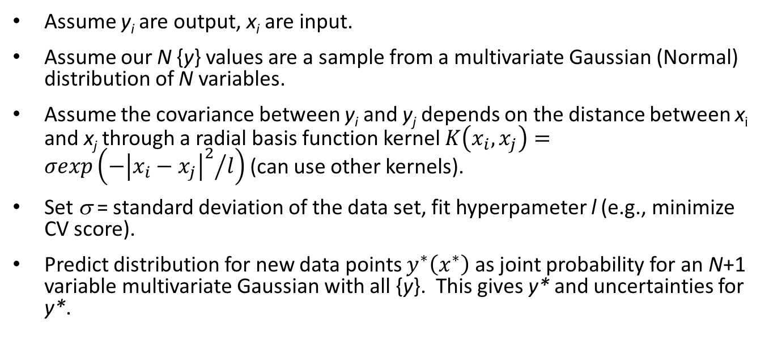
Gaussian Process Regression
Assume y_{i} are output, x_{i} are input.
Assume our N {y} values are a sample from a multivariate Gaussian (Normal) distribution of N variables.
Assume the covariance between y_{i} and y_{j} depends on the distance between x_{i} and x_{j} through a radial basis function kernel $K\left(x_{i},x_{j}\right)=σexp\left({−{\left|x_{i}−x_{j}\right|}^{2}}/l\right)$(can use other kernels).
Set σ = standard deviation of the data set, fit hyperpameter l (e.g., minimize CV score).
Predict distribution for new data points $y^{∗}\left(x^{∗}\right)$ as joint probability for an N+1 variable multivariate Gaussian with all {y}. This gives y* and uncertainties for y*.
Need to explore how good these predictions and uncertainties will be for physical system given GPR assumptions and limited data.
Ebden, M. Gaussian Processes: A Quick Introduction. (2015) <http://arxiv.org/abs/1505.02965>

Slide 29
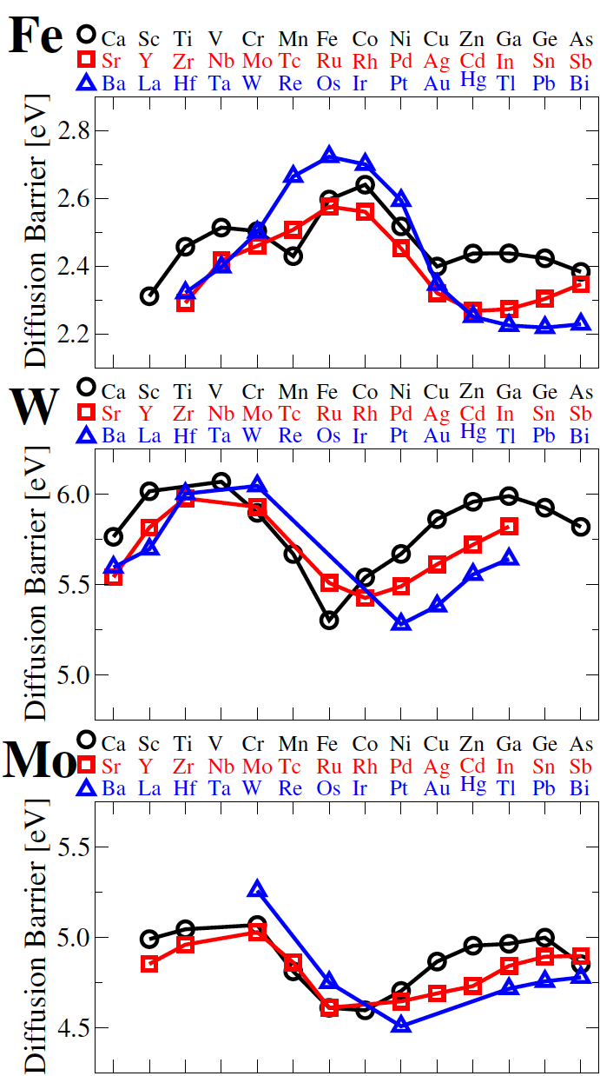
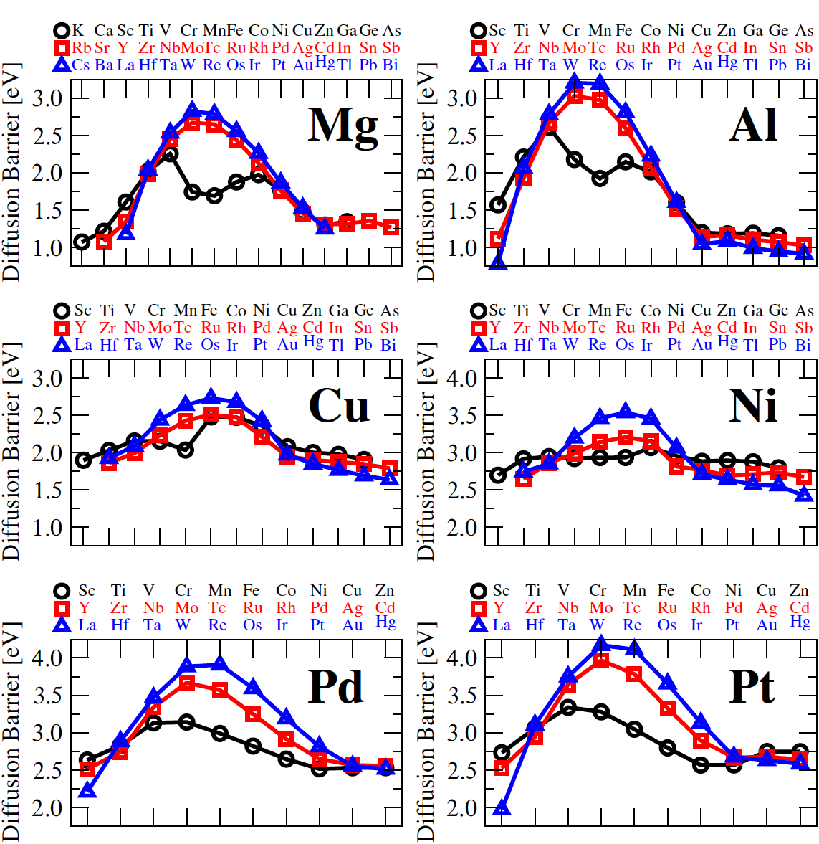
Diffusion Database http://diffusiondata.materialshub.org/
BCC
FCC
Large database shows clear trends, e.g., vs. column, FCC vs. BCC, magnetic elements in FCC, etc.

Slide 30
Gaussian Kernel Ridge Regression
We have systems M-X labeled with i, and descriptors labeled with j for each M-X system. Assume y_{i} are output, x_{i,j} are input descriptors
Find {a_{j}, σ, λ} that minimize
Kernel is
New values are given by
The key idea:
Associate a vector with each x and and give the projection of x on x’ by K(x,x’).
Each new value y*(x*) is a linear combination of projections of x_{i} on x* (K(x_{i},x*)) with coefficients fit to existing data (and with smoothing).
G. Montavon, et al., NJOP ‘13.
A. Gretton, Introduction to RKHS, and some simple kernel algorithms, 1/27/15 (lecture notes)

